Slide 1

UNITED STATES MILITARY
ENLISTED ACCESSIONS
NASHVILLE SOFTWARE SCHOOL CLASS DDA-14
Notes:
Hello My name is Cynthia Lightner and I’m in the Nashville Software school’s data analytics' class, cohort 14, and today I’m going to discuss US Military enlisted accessions.

Slide 2
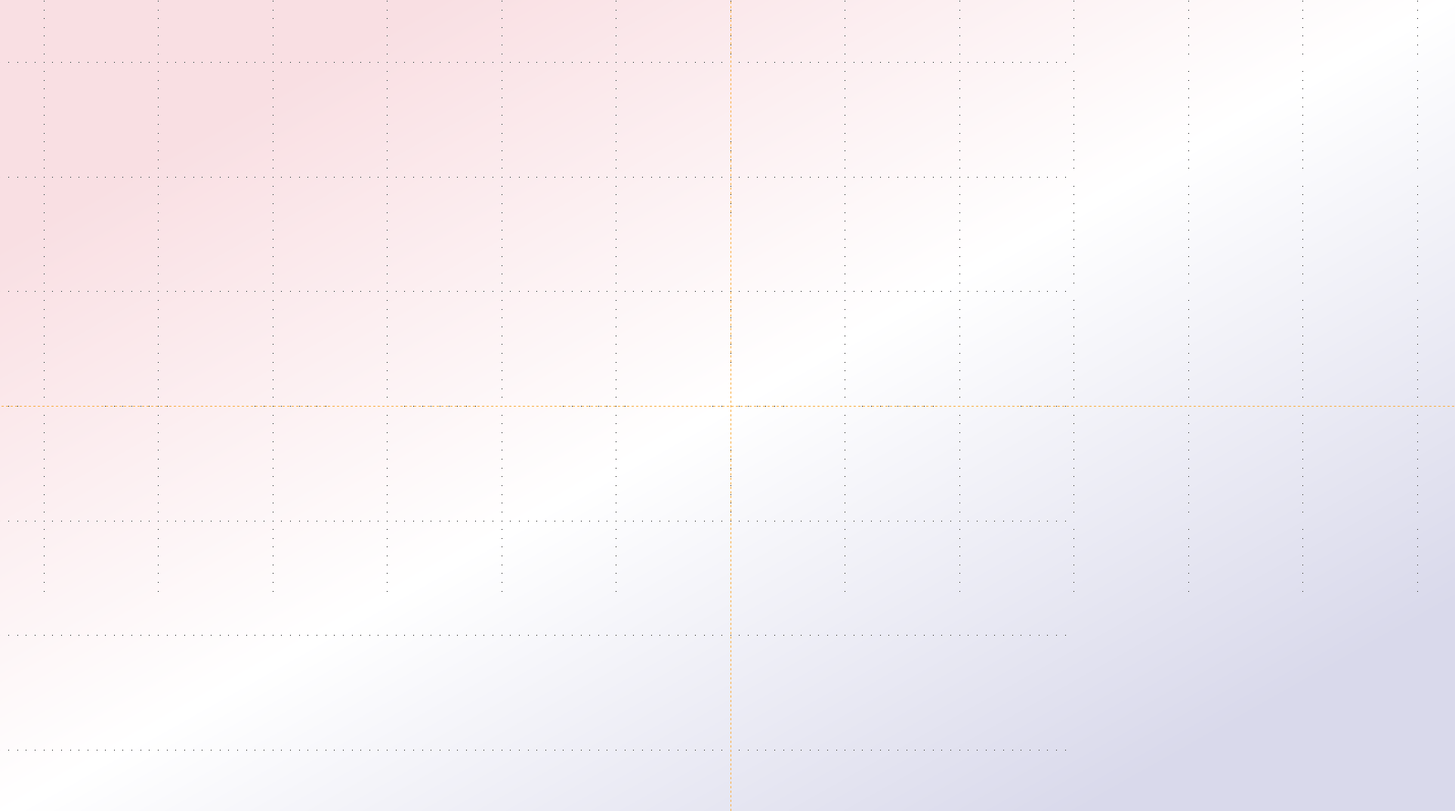


AGENDA
01
Introduction/Context
02
Overview
03
Project Questions and Findings
04
Limitations
05
Summary/Proposed Next Steps
06
Conclusion/Questions
Notes:
There are six portions to the presentation, and I will continue with the introduction, context and an overview

Slide 3
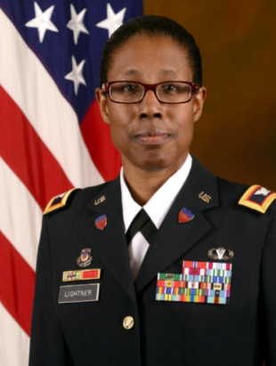
INTRODUCTION/CONTEXT
“Only 1 percent of our population today will ever wear the uniform of this nation in any of its incarnations -- soldier, sailor, airman, Marine, active, Guard or Reserve,” Air Force Gen. Paul J. Selva, Vice Chairman of the Joint Chiefs of Staff
Vice Chairman Salutes The 1 Percent of Population That Serves > U.S. Department of Defense > Defense Department News
Notes:
This quote is from the vice chairman of the Joint Chiefs, I had heard that same statistic used a lot when I was in the Army, that’s me in the corner, and for this project I wanted to unpack the statement and explore issues around enlisted recruiting for the entire Department of Defense.
So I wanted to know explore issue around enlisted recruiting and determine if it was an issue across DoD or just the Army.
when he was speaking at the National Association of Collegiate Directors of Athletics and Affiliates Conference in 2018 in reference to military recruiting and the directors recruiting those same college-aged students.

Slide 4
BRIEFING NOTES
Department of Defense is DoD
I may use accession, enlistment, and recruiting interchangeably
I may refer to the period 2010 -2020 as decade
All years are fiscal years, except as noted below, annotated as FY on slides and a DoD fiscal year is from October 1st through September 30th
Gross Domestic Product (GDP) is measured in calendar years; therefore, I used the regular year for any graph using GDP
Notes:
For this project:
-I will use DoD as an acronym for the Department of Defense
-I will use accession and enlistment or recruiting interchangeably
-You may hear me refer to the year from 2010-2020 as decade
-All years are fiscal years, annotated as FY on slides, with the exception noted below (next slide)
-GDPPC is measured in calendar years, and when comparing GDPPC to ENACC, I used the regular calendar year.

Slide 5
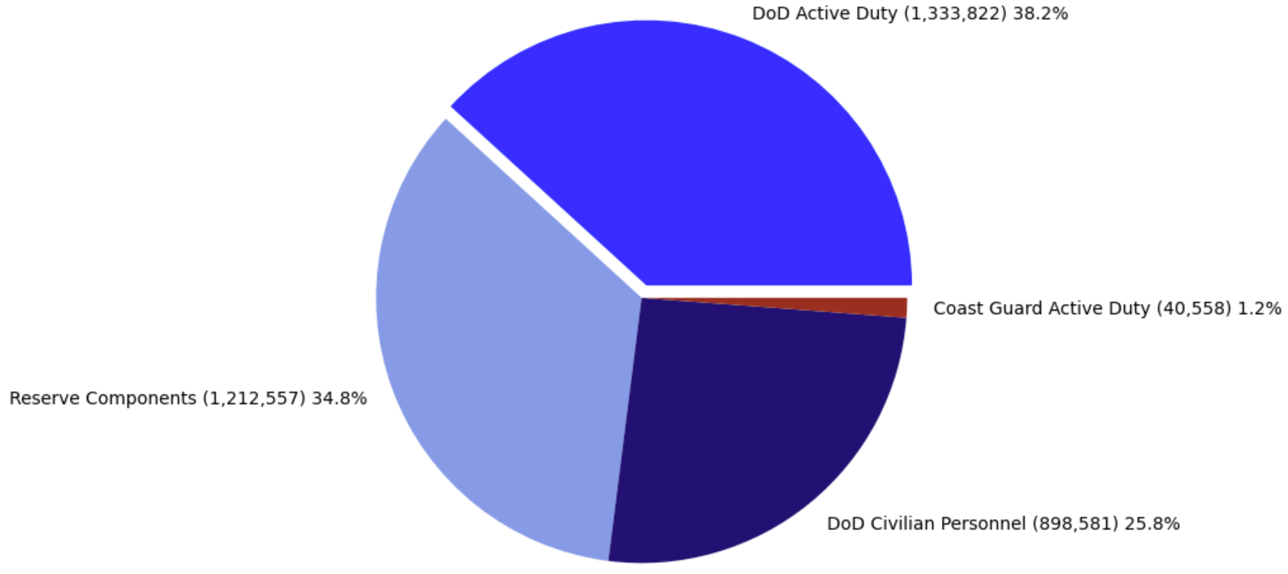
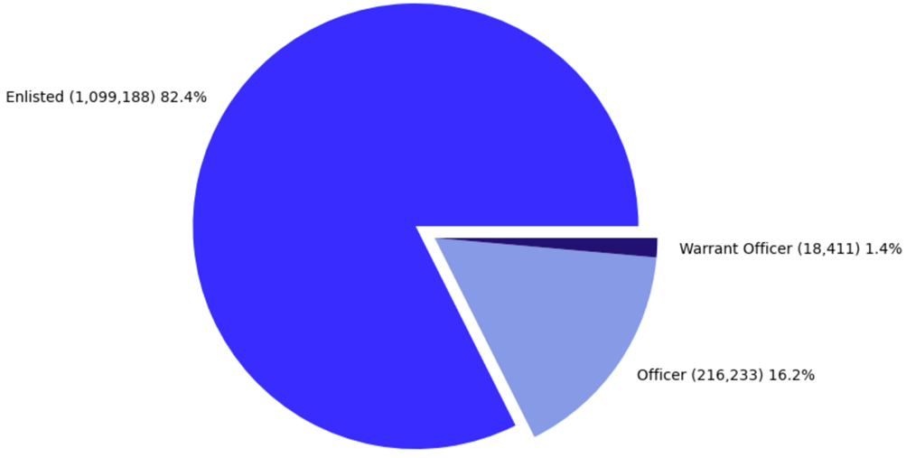
OVERVIEW
TOTAL FORCE BY COMPONENT FY2020
Notes:
When examining Enlisted Accessions, I am going to start with the big picture, which is the Total Force. The left pie chart represents the Total Force breakdown for FY2020. The Total Force is an integrated approach to the national defense posture that combines Active Duty, Reserve Components, National Guard members, Civilians, and the Coast Guard as available resources for the readiness posture for the US.
For this project, I am focusing on the AD component, which is the pie chart on the right, and you can see enlisted forces make up the majority of the DoD AD forces.
The take-away from this slide is that is meeting targets for enlisted recruiting is important to the national defense posture due to the lag time needed to train quality leaders, and before you can lead, you have to join the team and learn to follow. And joining the team is where enlisted accessions start.
was comprised of approximately 82 percent enlisted personnel (1,099,188), the largest share of the AD force, and 17.6 percent officers (234,634). The take-away from this slide is that is meeting enlisted recruiting target is important to the national defense posture due to the lag time needed to create/train quality leaders, and before you can lead, you have to join the team and learn to follow. And joining the team is where enlisted accessions start.
Most folks are familiar with AD, Reservist, and NG service members, but I want to point out while Civilians are not a fighting force, they are essential to how the military functions, especially during conflicts and deployments. Also, the Coast Guard is not normally a DoD asset. They fall under DHS, the Department of Homeland Security, but they have important maritime skills and rolls and can augment any DoD assets.
For this project, I am focusing on the AD component, which is the pie chart on the right, and the largest portion of total forces. The take-away from this slide is that is meeting enlisted recruiting target is important to the national defense posture due to the lag time needed to create/train quality leaders, but before you can lead, you have to join the team and learn to follow. And joining the team is where enlisted accessions start.
DoD AD force was comprised of approximately 82 percent enlisted personnel (1,099,188) and 17.6 percent officers (234,634). Again, this project is focused on enlisted recruitment. When enlisted accesses decrease, this bubble travels through the system. The Pentagon can try to access more people in subsequent years, but runs the risk of creating deleterious effects on training and the general readiness of the force. It takes time to grow leaders and in the best case scenario, DoD has that time, but as former Defense Secretary Donald Rumsfeld stated, and I’m paraphrasing, you go to war with the Army, Navy, Air Force, Marine Corps you have, not the force you might want to have at a later time.
My point is meeting accession targets is important to the national defense posture due to the lag time needed to create/train quality leaders, and Non Commission officers are the bulk of Enlisted Service Members. You have junior enlisted, junior NCOs and senior NCOs, noncommissioned officers all in the bright blue. But before you can lead, before you can become an NCO, you have to join the team and learn to follow. And joining the team is where enlisted accessions start.
Total Force Definition
The Total Force refers to an integrated approach to the national defense posture that combines active duty, Reserve Components, National Guard members, Civilians, and the Coast Guard, and Policy is the Department of Defense policy of using reserve component forces as the primary and essential augmentation for the active component force in any medium to large deployment of forces.
The Ready Reserve is a U.S. Department of Defense program which maintains a pool of trained service members that may be recalled to active duty should the need arise. It is composed of service members that are contracted to serve in the Ready Reserve for a specified period of time as a reservist or in active duty status. Members of the Ready Reserve are required to be prepared for mobilization or re-activation within a specified period of time, maintain a serviceable uniform, and maintain a degree of fitness.
The retired reserve contains the military's retired members who have put in at least 20 years of active duty service. These members are not discharged and, as such, may be called back to active service under certain circumstances, such as war or national emergency.
For officers who do not choose whether or not to stay in the Active Reserve, membership in the Standby Reserve is limited to one year, after which they must determine if they are transferring to the Individual Ready Reserve, or to a drilling unit. The Standby Reserve is also used for personnel who have been designated key civilian employees, or who have a temporary hardship or disability. As such, they are not required to perform training and are not a part of units, but create a pool of trained individuals who could be mobilized if necessary as a last resort to fill manpower needs in specific skills.

Slide 6
PROJECT QUESTIONS AND FINDINGS
PQ3: Is
there a relationship between GDP Per Capita and Enlisted Accessions?
PF3: No. The correlation between GDP Per Capita and Enlistment is very weak
PQ1: What are the Enlisted Accession trends over time?
PF1: Enlisted Accession have been decreasing over time
PQ2: Are there areas
where Enlisted Accessions differs from the population?
PF2:
*NORTHEAST< *MIDWEST< *SOUTH> *WEST =
Notes:
These are my three project questions and findings from the data and now I am going to share my questions and findings in detail.

Slide 7


PROJECT QUESTION 1
What are the Enlisted Accession trends over time?
Notes:
What are the recruiting trends over time in the US

Slide 8
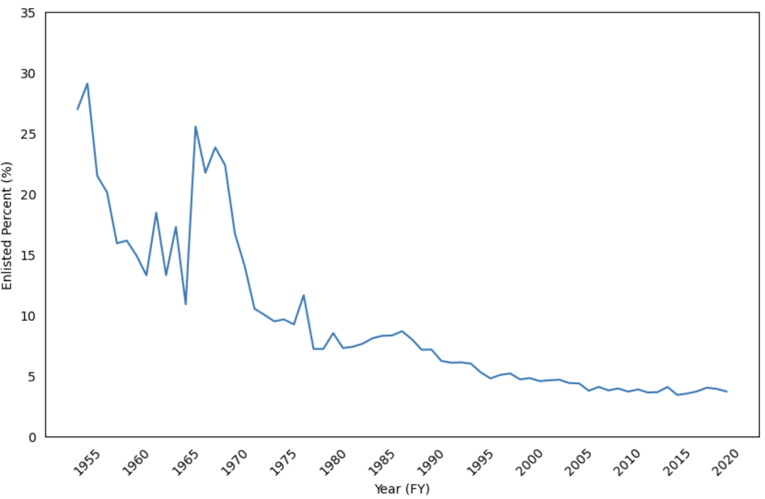
PERCENT ENLISTED ACCESSIONS US ARMED FORCES
AGE 18 , FY1954-2020
PQ1: What are the Enlisted Accession trends over time?
Notes:
#Here is a snapshot of enlisted data from 1954 to 2020, for 18-year-olds, the typical target audience for recruiters. This data indicates a general decline in enlisted accessions across 6 decades for AD forces, except for the significant spike at 954-55 during the Korean Conflict, and from 1965-1970. due to the Vietnam Conflict. From 1948 until 1973, DoD used conscription or the draft during both peacetime and periods of conflict, so this doesn’t represent the all-volunteer force of today.
#https://www.cna.org/pop-rep/2019/appendixd/d_01.html#Accessions reported for 1954-1963 include males only; including females would increase accessions by less than 2 percent. #Source: Military data are provided by the Defense Manpower Data Center (DMDC). Civilian data prior to 1989 represent calendar year.
#I found anecdotal evidence that volunteer enlistment did increase among Black and Latino men, due in part to policies designed to attract recruits, #such as equal access to the benefits of the GI bill at local levels and the 1966 Veterans Readjustment Benefits Act, #which provided education benefits, home and farm loans, employment counseling and placement services for Vietnam Veterans. However, it is more likely these number represent those drafted AND volunteers, but without access to additional data, I cannot adequately address this spike.

Slide 9
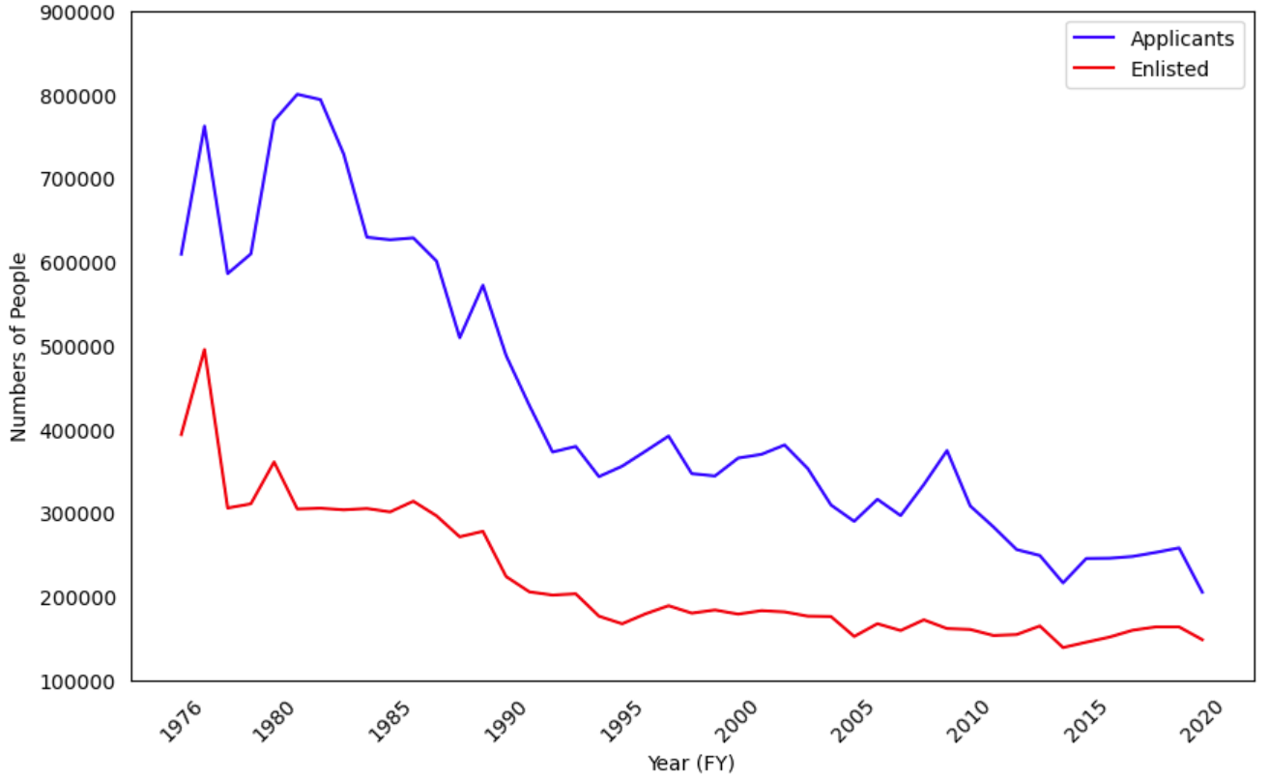
NUMBER OF APPLICANTS VS PEOPLE ENLISTING
IN THE US ARMED FORCES, FY1976-2020
PQ1: What are the Enlisted Accession trends over time?
Notes:
This chart shows the post Vietnam enlisted accession posture through 2020 for the US and is depicts the same trend of declining accessions. Additionally, while the red line show those entering the US military, the blue line shows those who tried to enter, but for whatever reason, did not.
So not only does this show a decline in numbers of entrants, it also shows a similar decline in applicants.
#I couldn’t find separate volunteer data until the early 70s because From 1948 until 1973, during both peacetime and periods of conflict, #men were drafted to fill vacancies in the armed forces which could not be filled through voluntary means. #Draft (or induction/conscription) authority expired in 1973, but the Selective Service System remained in existence in “standby” to support #the all-volunteer force in case of an emergency. #Registration was suspended early in 1975 and the Selective Service System entered into “deep standby”.#https://www.sss.gov/history-and-records/

Slide 10
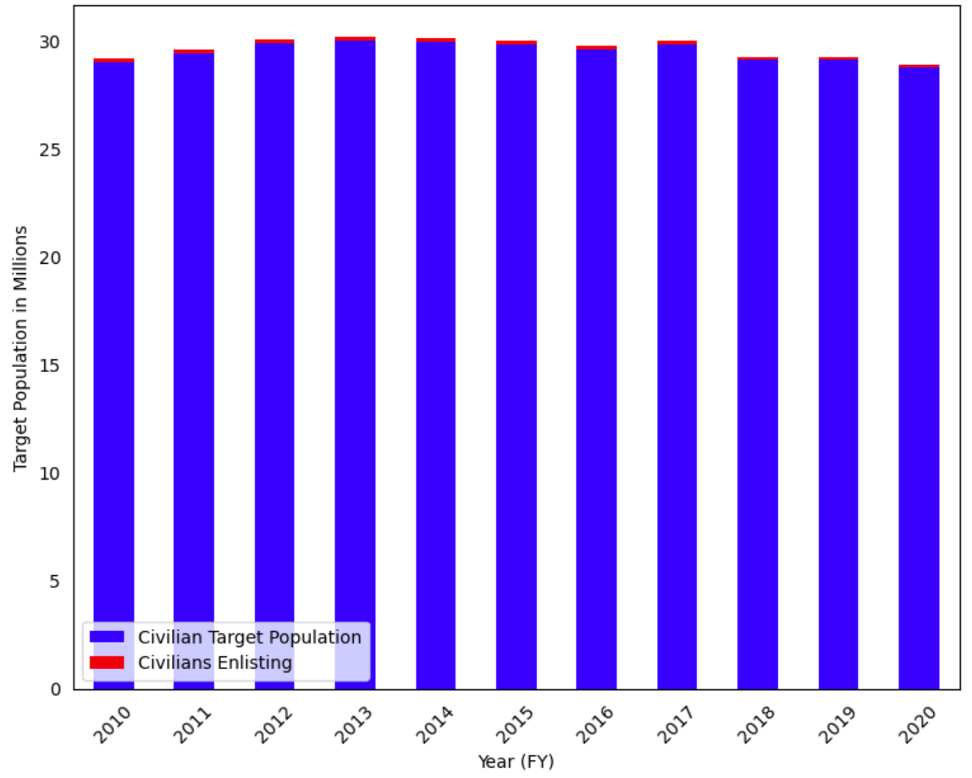
NUMBER OF CIVILANS AGED 18-24 VS THOSE ENLISTING IN THE US ARMED FORCES FY2010-2020
PQ1: What are the Enlisted Accession trends over time?
Notes:
This represent two issues: the red at the top reiterates the small proportion of people in the target population who enlist compared to the whole target population in blue from 2010-2020. We can also see a slight decrease in the number of the entire target population over time, which may speak to larger US demographic trends.

Slide 11
PROJECT FINDINGS 1
Enlisted Accessions have been decreasing over time
Notes:
So the data showed a decline in enlisted accessions in the US

Slide 12

PROJECT QUESTION 2
Are there areas where Enlisted Accessions differs from the population?
Notes:
My second question: Are there areas in the US where enlisted accessions differs from the target population, those aged 18-24?

Slide 13
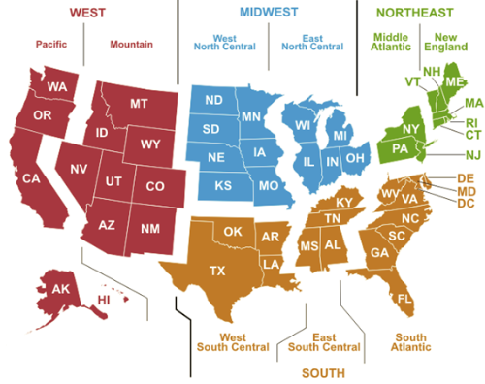
UNITED STATES CENSUS REGIONS AND DIVISIONS
Notes:
These are the Census Bureau regions for the United States and there are four regions, WEST, MIDWEST, NORTHEAST, and SOUTH, with nine subregions, or division, 2 in each region, except the SOUTH which has 3 division. I started by exploration of the data by regions.
https://www.eia.gov/consumption/commercial/maps.php

Slide 14
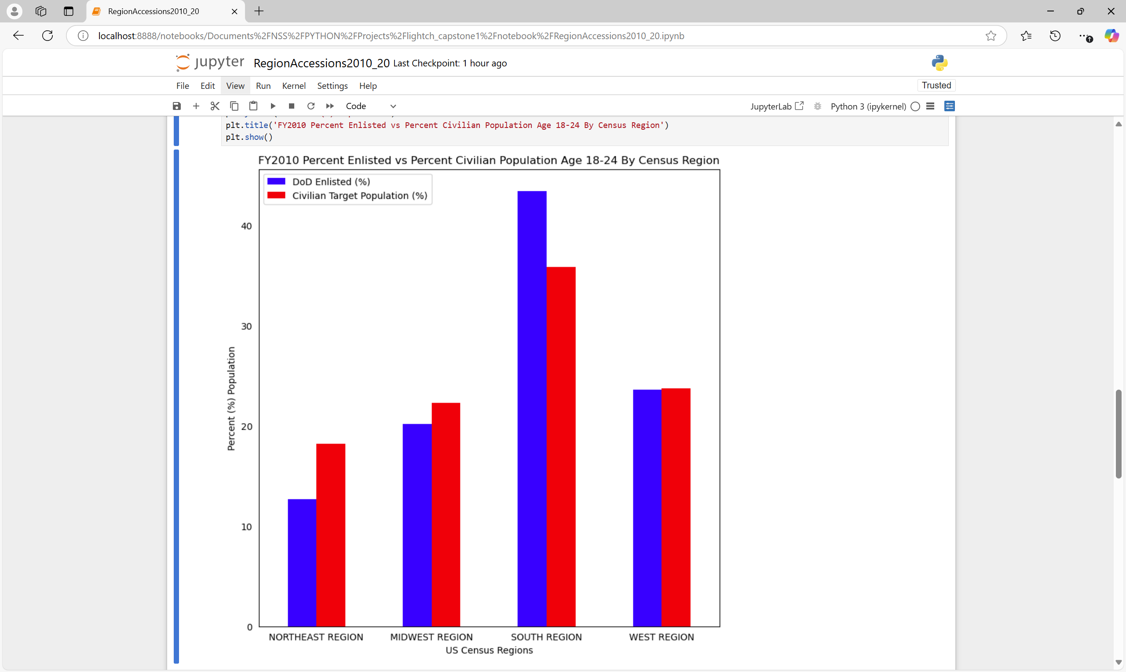
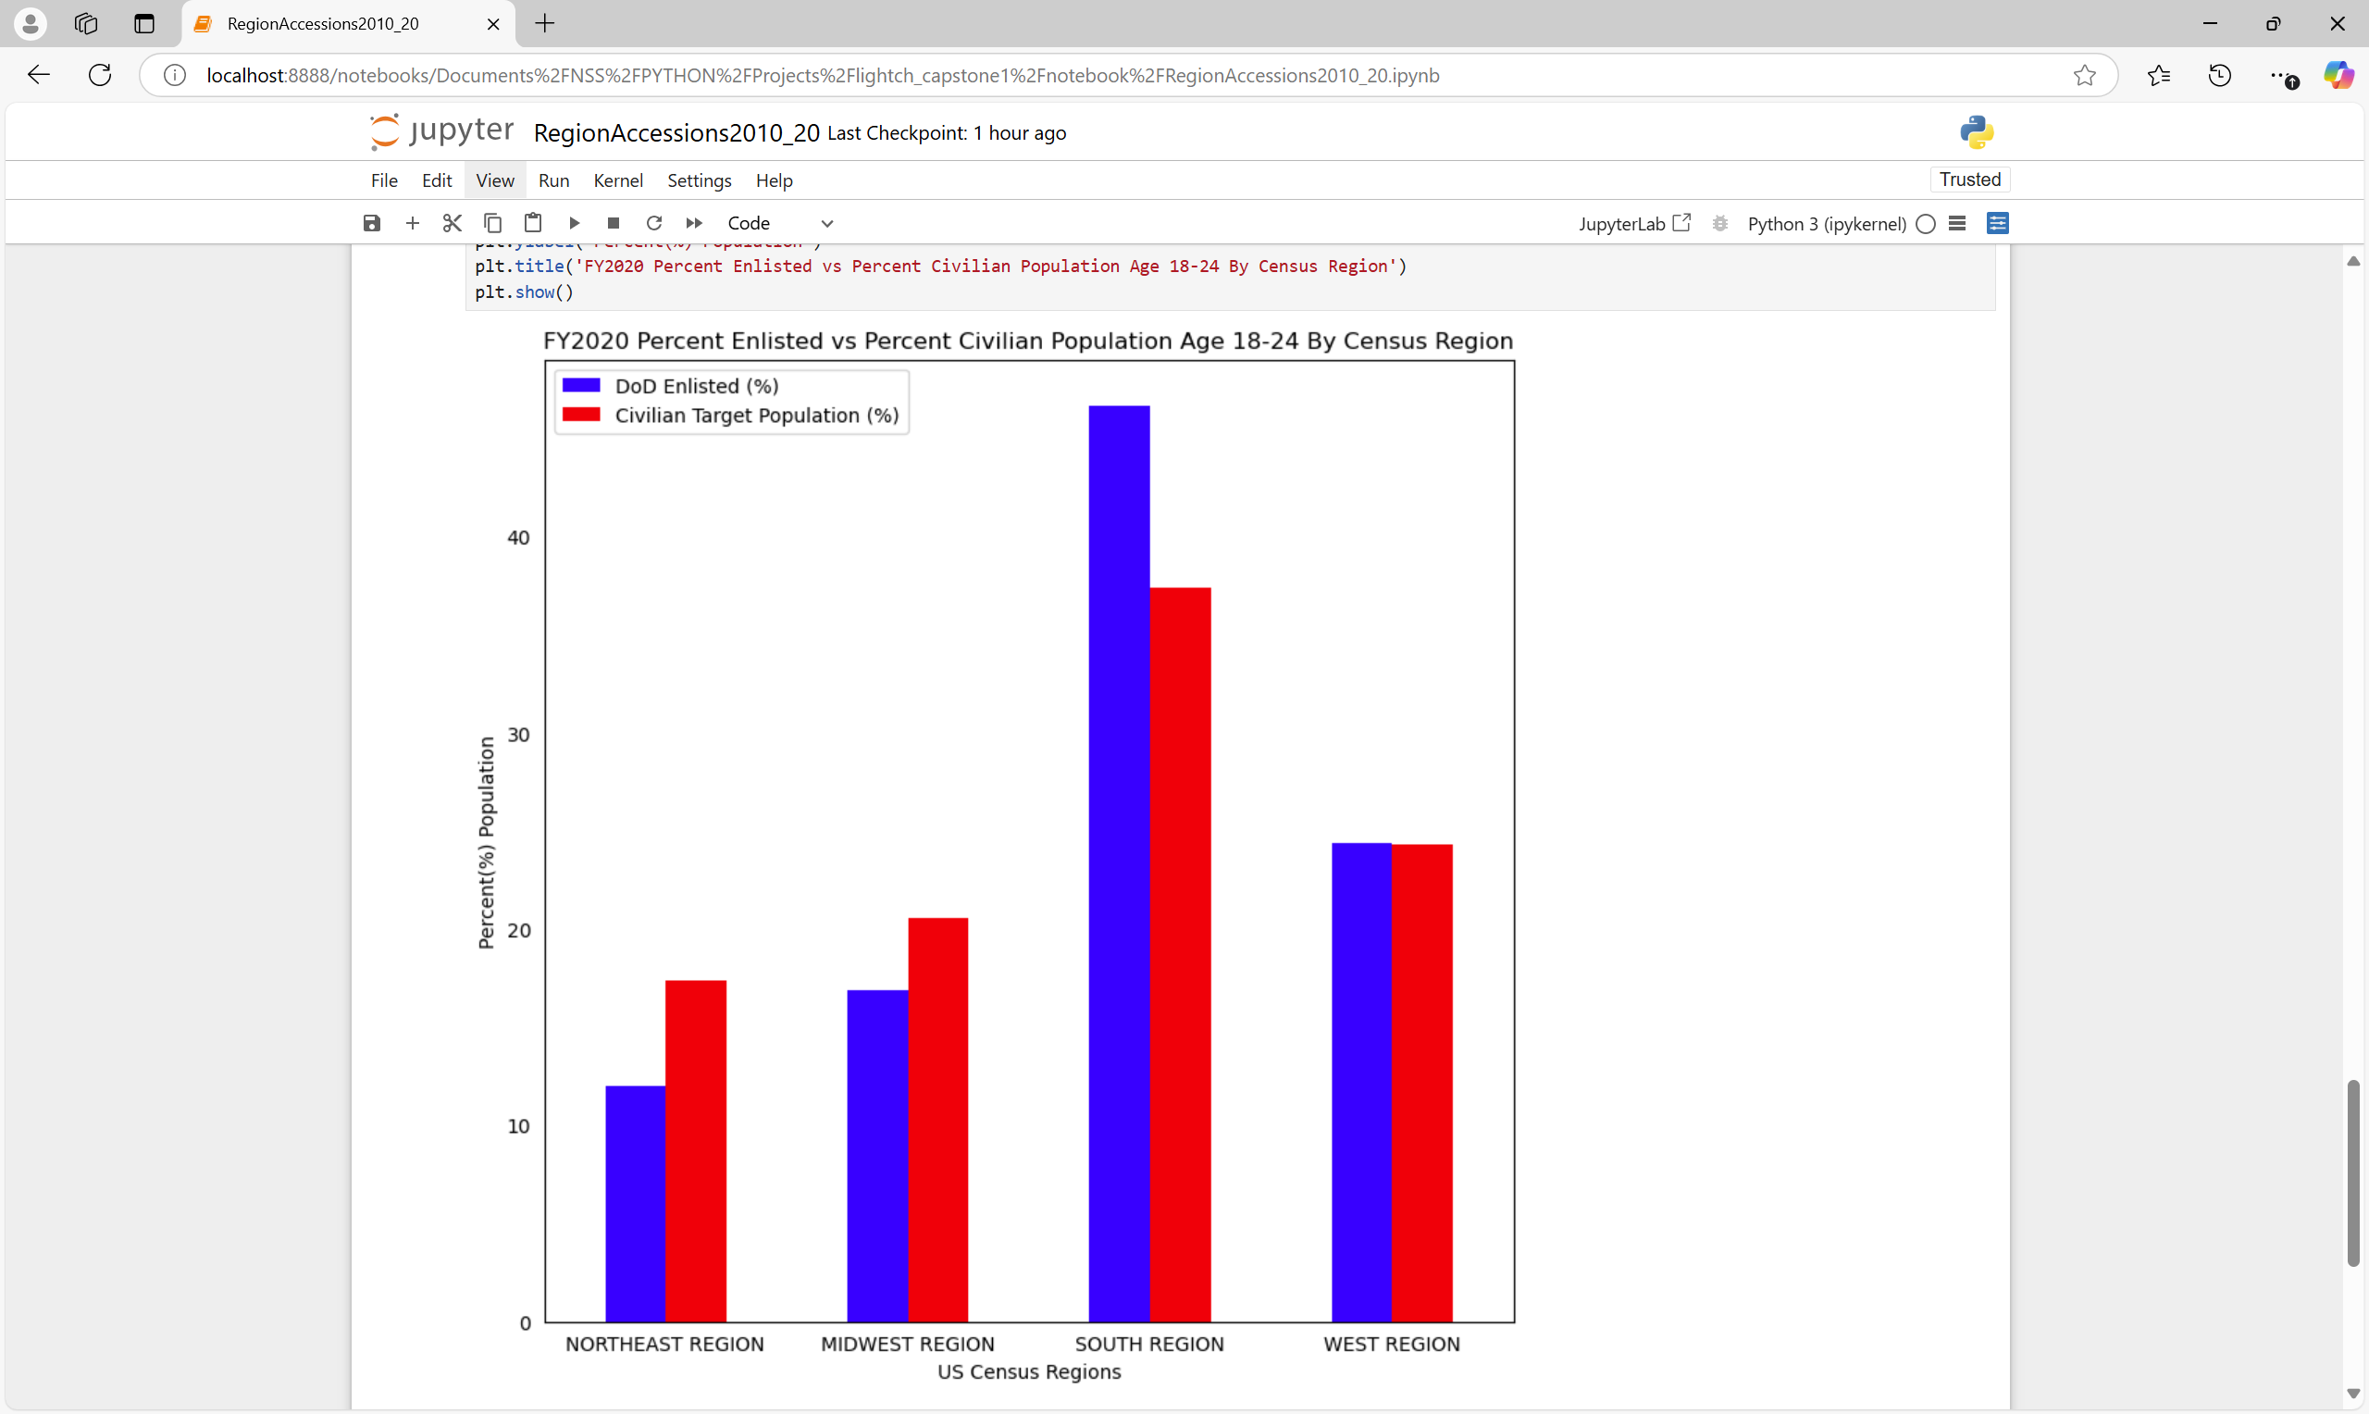
ENLISTED ACCESIONS FY2010 VS FY2020
BY REGION
PQ2: Are there areas
where Enlisted Accessions differs from the population?
Notes:
#This shows that for 2010 and 2020, the percentages of those enlisting by regions were very similar. In the NORTHEAST and MIDWEST the blues bars showing enlistment were lower than the red bars representing percentages the target population in each region. For the SOUTH, recruitment was higher than the population percentages #The WEST region was on par. This holds constant across the years

Slide 15
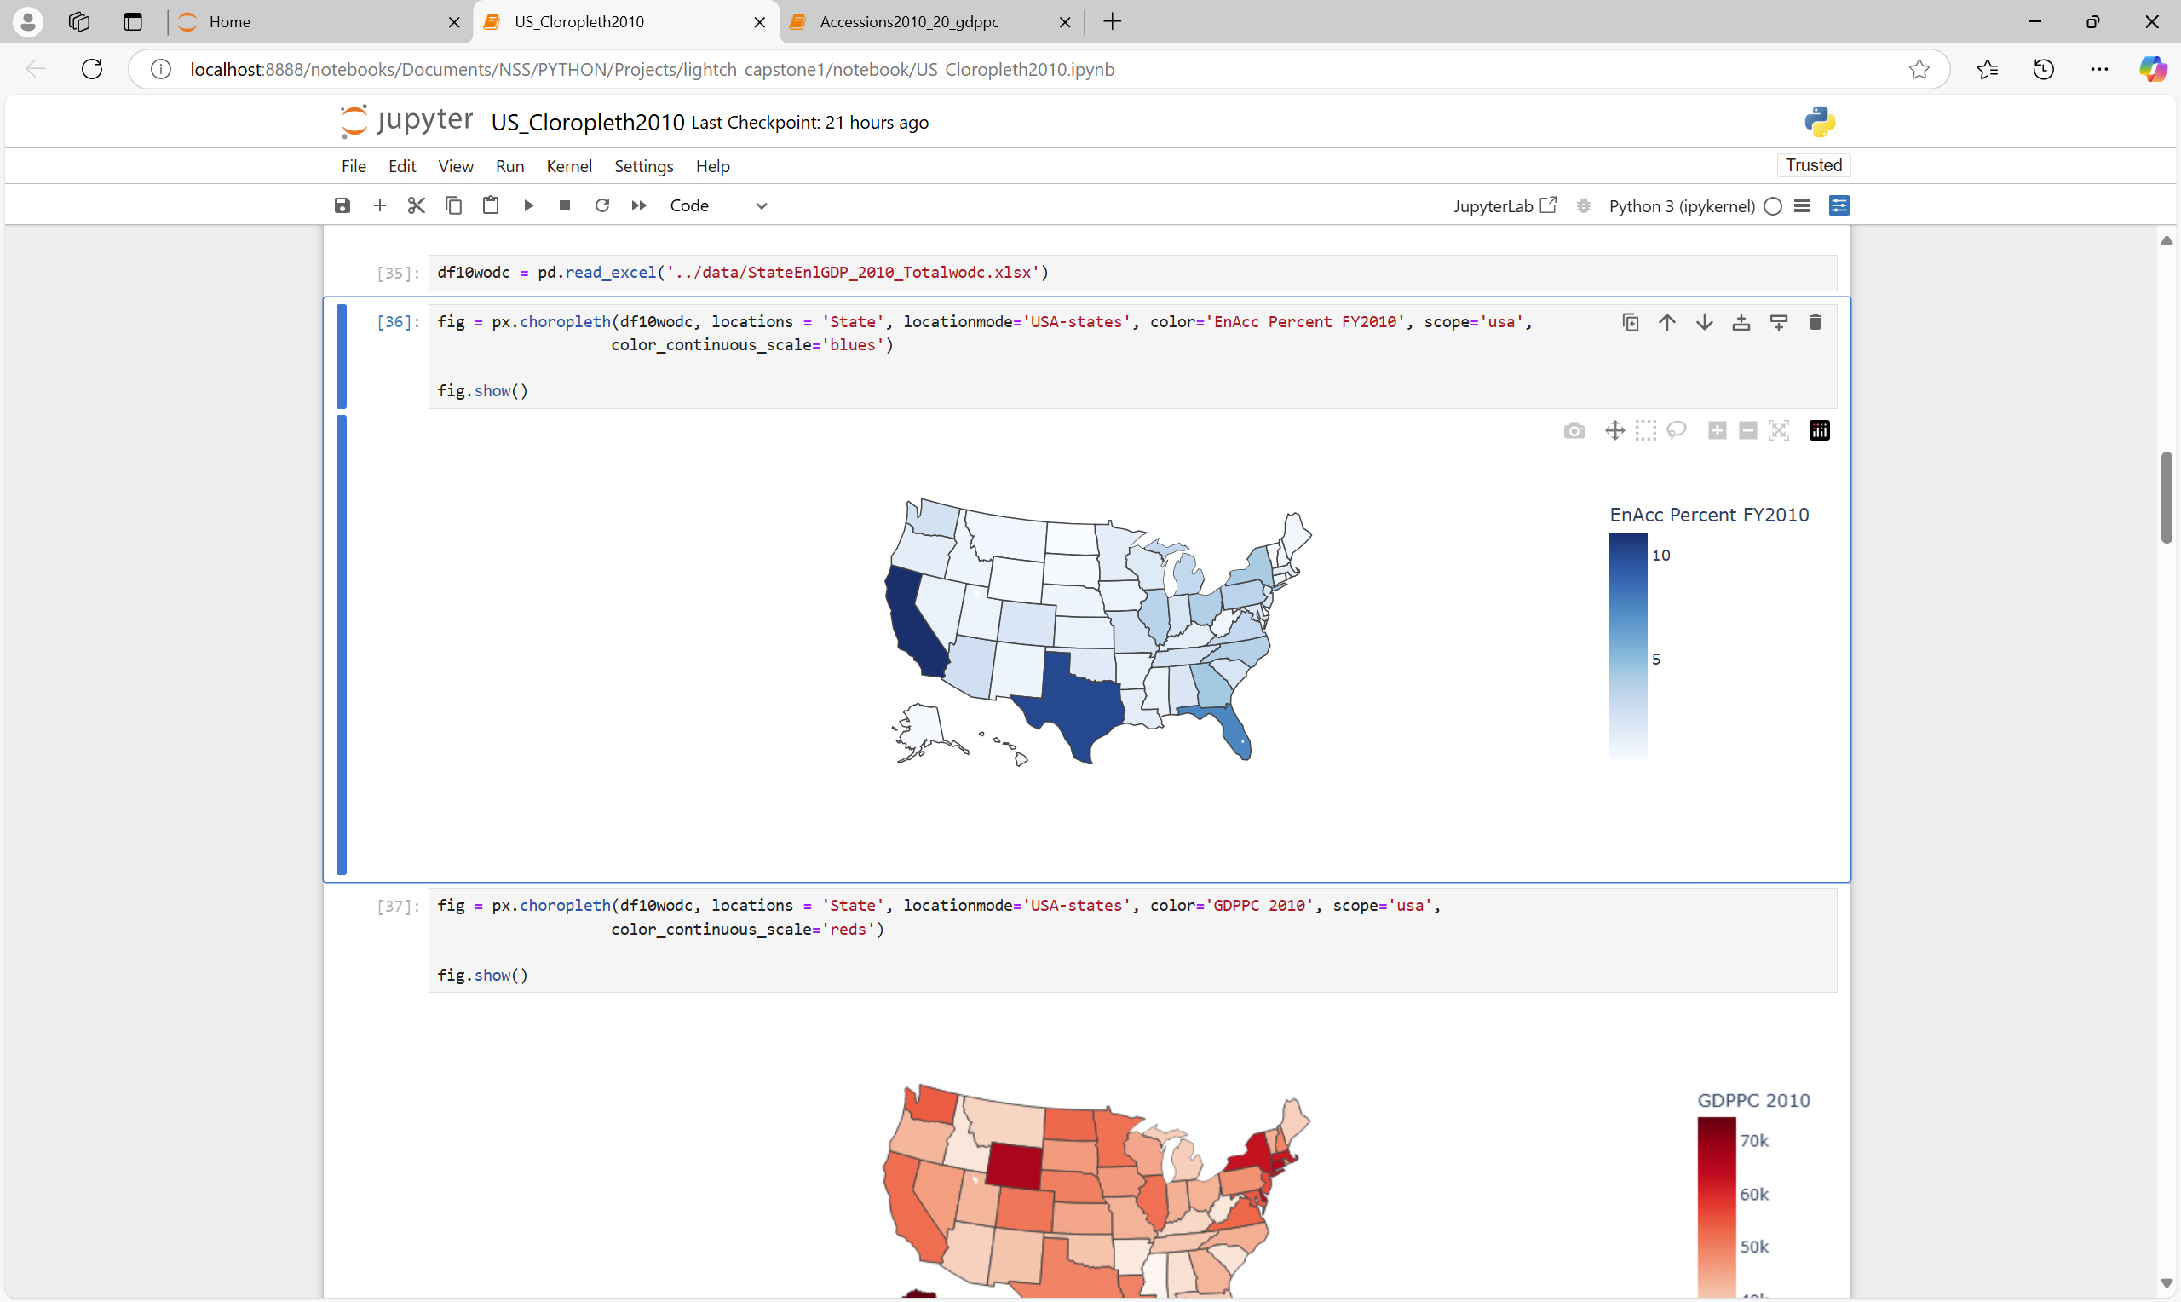
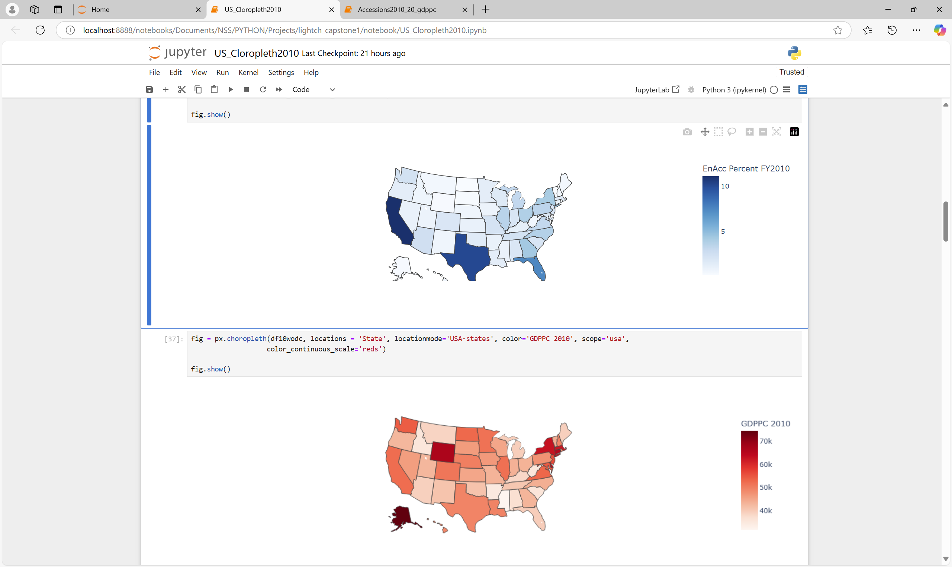
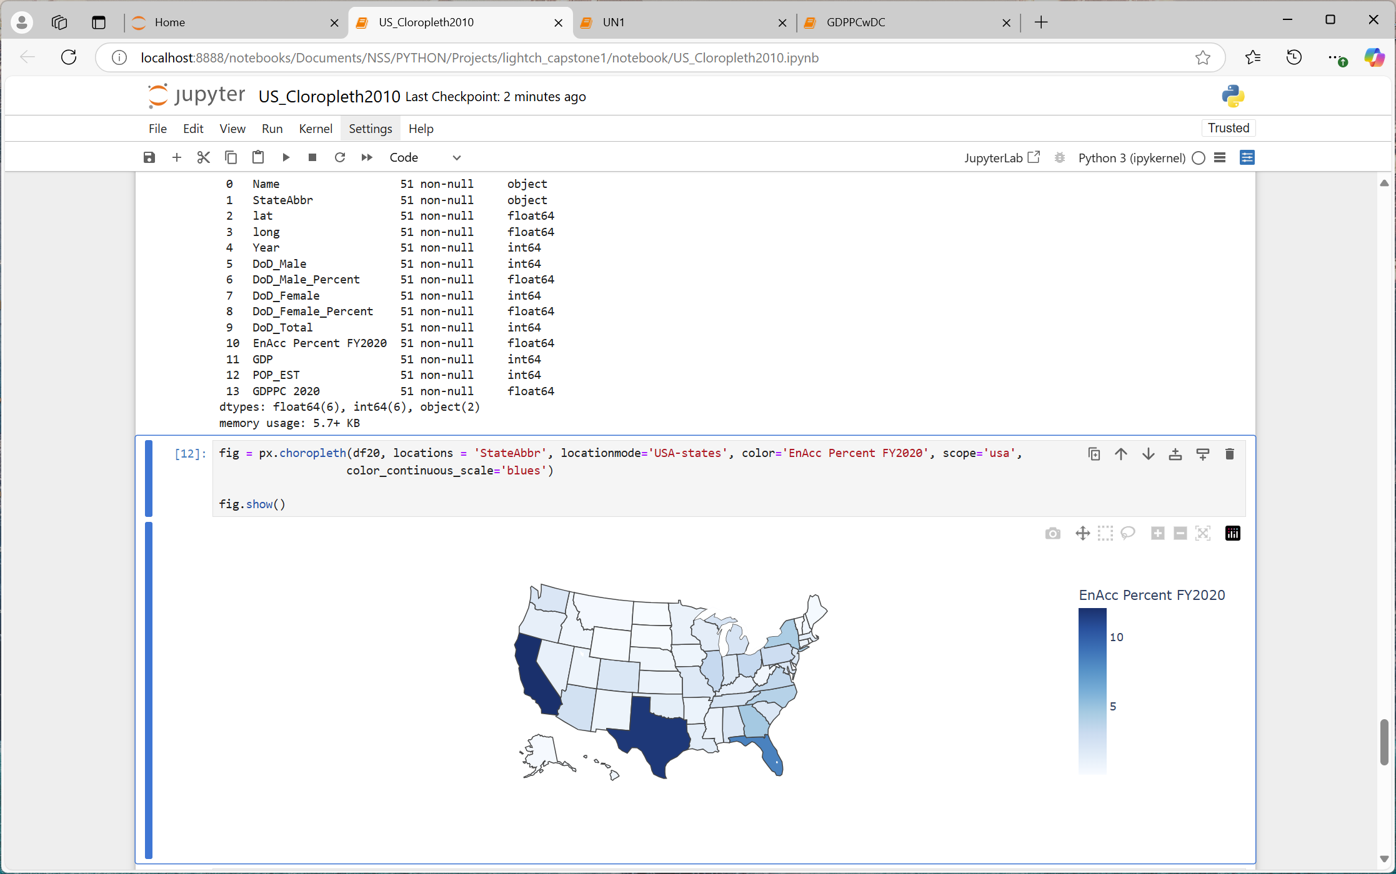
ENLISTED ACCESIONS FY2010 VS FY2020
PQ2: Are there areas
where Enlisted Accessions differs from the population?
Notes:
After examining the regions, I wanted to examine the state numbers over time. This shows that for 2010 and 2020, the percentages of those enlisting by states were very similar. it is difficult to note any differences in recruiting percentages over time. Additionally, the SOUTH region contains TX, FL, GA, NC, Virginia, states with the highest percent enlisted, showing why the SOUTH region consistently exceeds recruitment.

Slide 16
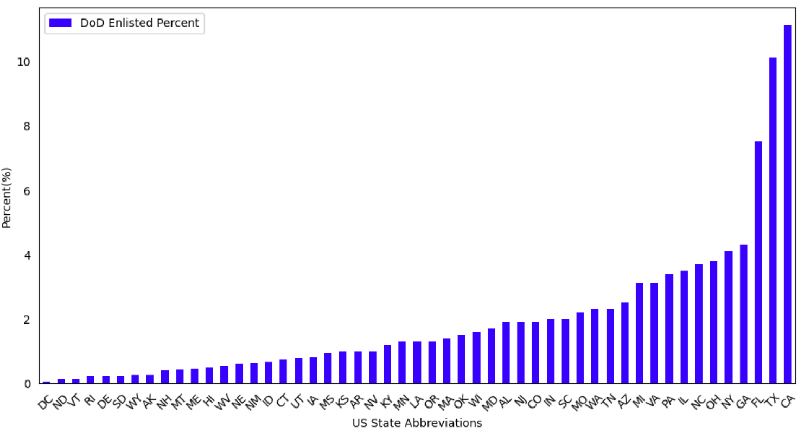
PERCENT ENLISTED ACCESSIONS BY STATE FY2010
TOP 10*
California | 11.10%
Texas | 10.10%
Florida | 7.50%
Georgia | 4.30%
New York | 4.10%
Ohio | 3.80%
North Carolina | 3.70%
Illinois | 3.50%
Pennsylvania | 3.40%
Michigan | 3.10%
Virginia | 3.10%
PQ2: Are there areas
where Enlisted Accessions differs from the population?
Notes:
You can see the top 10 states in 2010 and 2020 are similar. Notice DC has the lowest enlisted percentages across time.

Slide 17
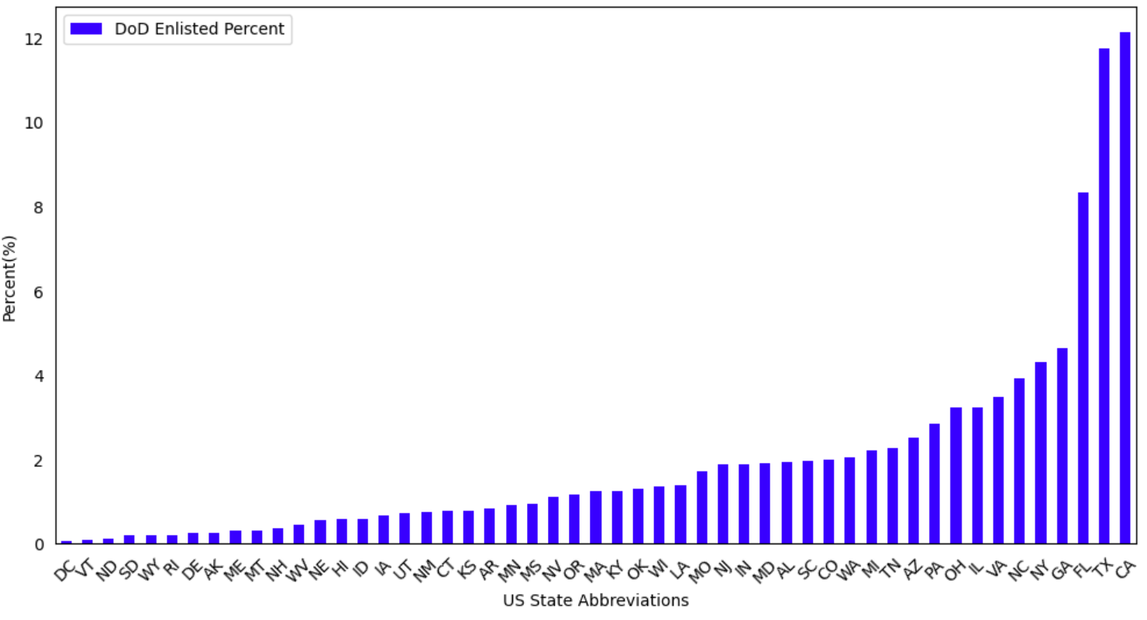
PERCENT ENLISTED ACCESSIONS BY STATE FY2020
TOP 10
California | 12.12%
Texas | 11.74%
Florida | 8.32%
Georgia | 4.63%
New York | 4.32%
North Carolina | 3.91%
Virginia | 3.47%
Illinois | 3.24%
Ohio | 3.23%
Pennsylvania | 2.85%
PQ2: Are there areas
where Enlisted Accessions differs from the population?

Slide 18
PROJECT FINDINGS 2
Across FY2010-2020, the SOUTH Region is where the percent of enlisted accessions exceeds the percent of the region’s target population
The NORTHEAST and MIDWEST Regions were where the percent of enlisted accessions were lower than the percent of the region’s target population
In the WEST Region, the percent of enlisted accessions was on par with the region’s target population
Notes:
Across time, the SOUTH consistently exceeded percent recruitment based on its target populations. Recruitment in the NORTHEAST and MIDWEST was consistently lower, and the WEST was on par in recruiting compared to its target population.

Slide 19

PROJECT QUESTION 3
Is there a relationship between GDP Per Capita and Enlisted Accessions?
Notes:
Question 3: Is there a relationship between GDPPC and ENACC

Slide 20
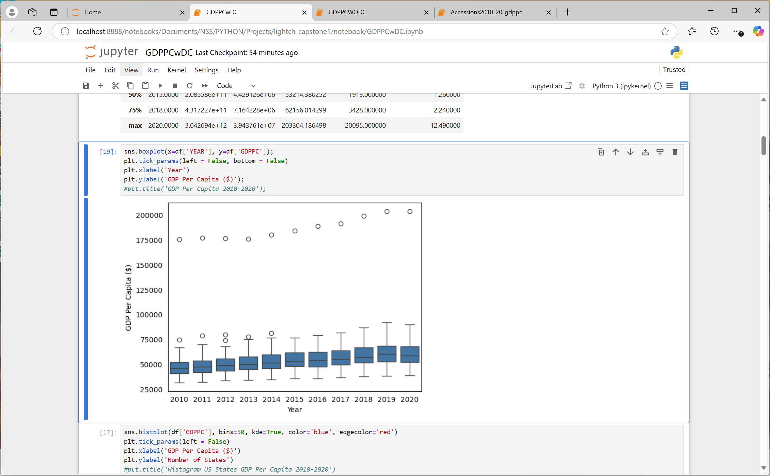
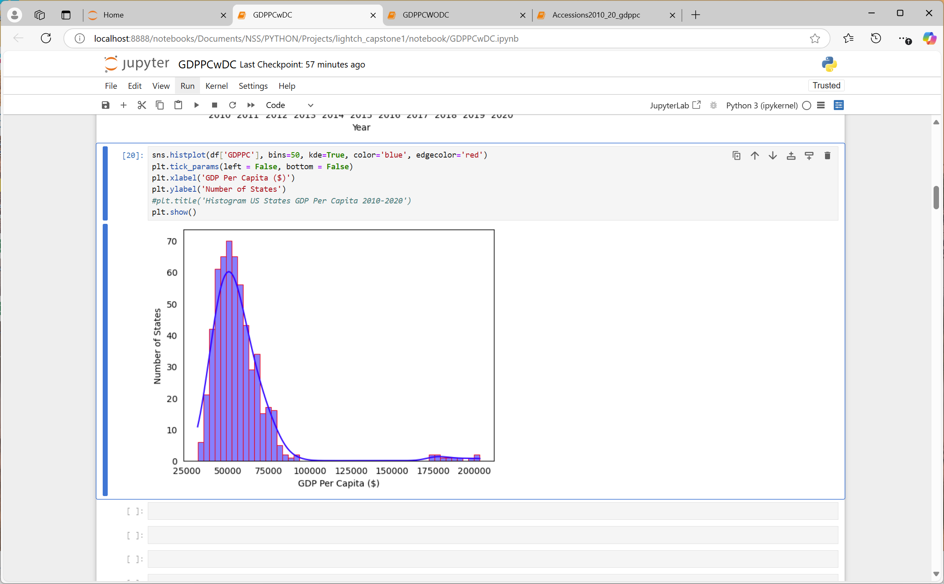
US GDP PER CAPITA 2010-2020
PQ3: Is there a relationship between GDP Per Capita and Enlisted Accessions?
Notes:
This was part of my exploratory data analysis, and you can readily see there are data skewing this GDP dataset. The histogram on the left with the density curve has a positive skew and the boxplot on the right you notice an outlier for every year with the dot at the top. Any guesses which state this is?

Slide 21
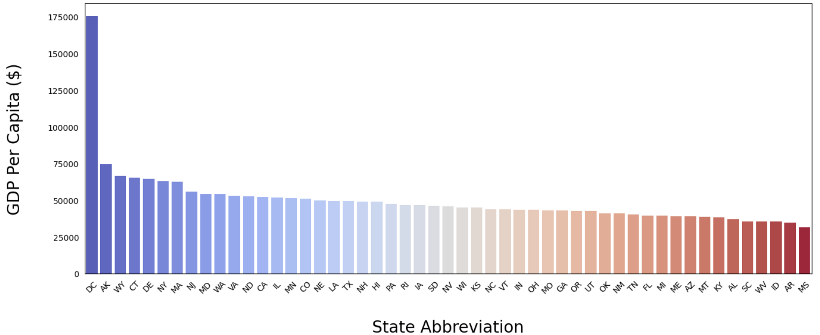
GDP PER CAPITA BY STATE 2010
PQ3: Is there a relationship between GDP Per Capita and Enlisted Accessions?
2010 US Mean (Average) GDPPC $49,710
Highest GDPPC: Washington DC $175,367
Lowest GDPPC: Mississippi $31,624
Median GDPPC: Nevada $46,131
Notes:
It is Washington DC, which is not a state, but was included in all the data, so I kept it in the data. This shows 2010, but DC has GDPPC over $175 thousand dollars from 2010-2020, exceeding $200 thousand in 2019 and 2020.

Slide 22
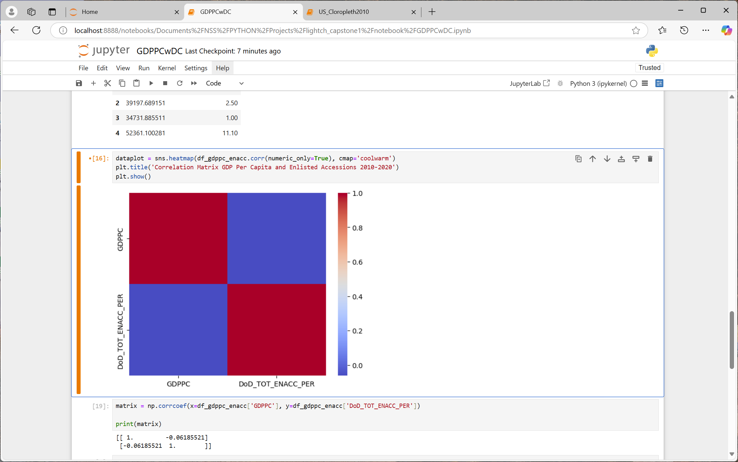
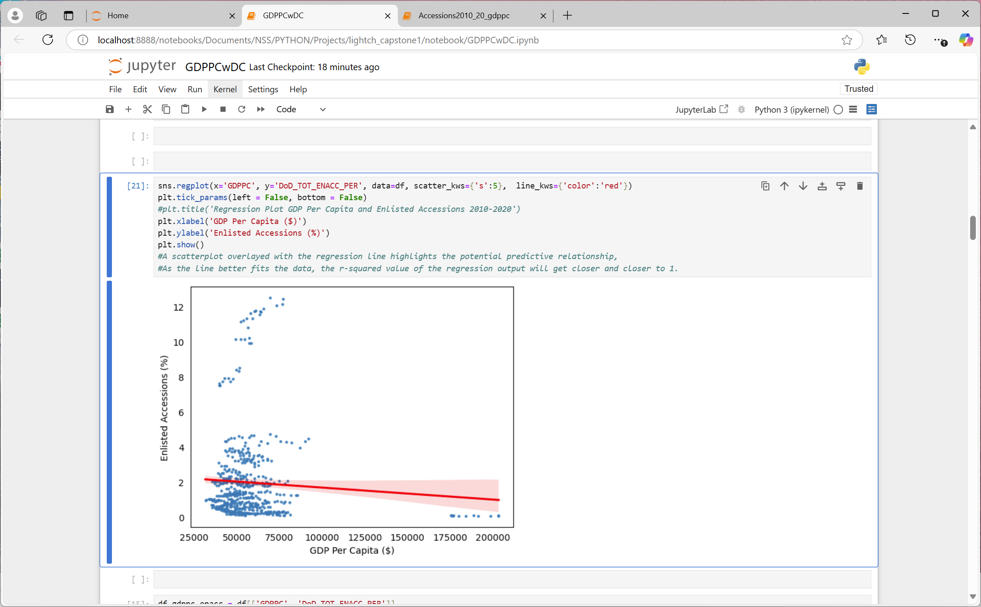
GDP PER CAPITA & PERCENT ENLISTED ACCESSIONS 2010-2020
PQ3: Is there a relationship between GDP Per Capita and Enlisted Accessions?
1 | -0.0619
-0.0619 | 1
Notes:
On the left, the scatter plot with the regression line highlights the potential predictive relationship between GDPPC and percent ENACC.
the red Regression line is predicting the value of ENACC, based on GDPPC, indicating a slight downward trend so from this, I anticipate the higher a state’s GDPPC, the lower the levels of enlistment, which is what I thought going into the project. SO I examined the correlation coefficient in the figures to the right.
Correlation lets us know the association or the absence of the relationship between two variables, again GDPPC and ENACC. The closer the correlation coefficient is to 1, the stronger the relationship and the coefficient’s sign indicates how the factors are moving in relation to one another.
This is showing -.0619, a negative correlation between the two, moving in opposite directions, so as one variable or factor increases GDPPC, the other decreases ENACC across time AND it’s not even a point 1, unless you round up, so the correlation coefficient is showing a very weak, almost non-existent relationship between GDPPC and ENACC across the decade. If the correlation coefficient was closer to one, we’d expect the blue quadrants to be more red, but as it stands, this is showing no relationship.
The blue dots represent the intersection of a state’s GDPPC and its percent ENACC. An

Slide 23
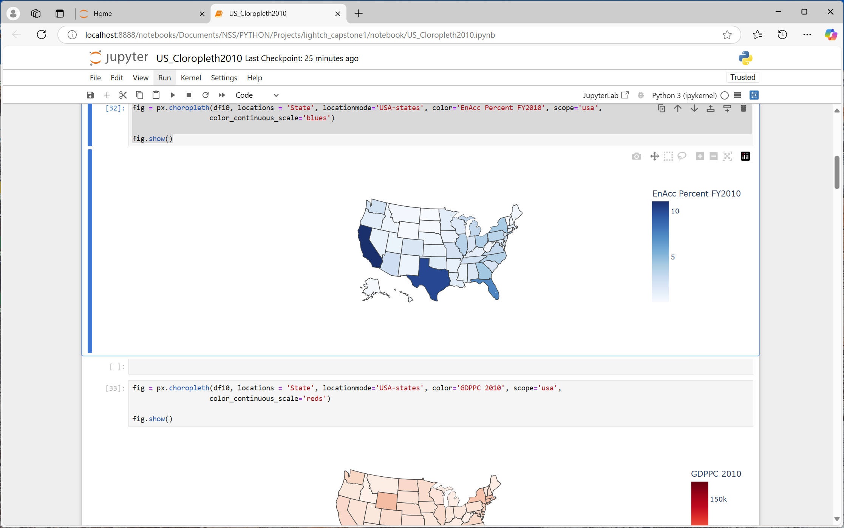
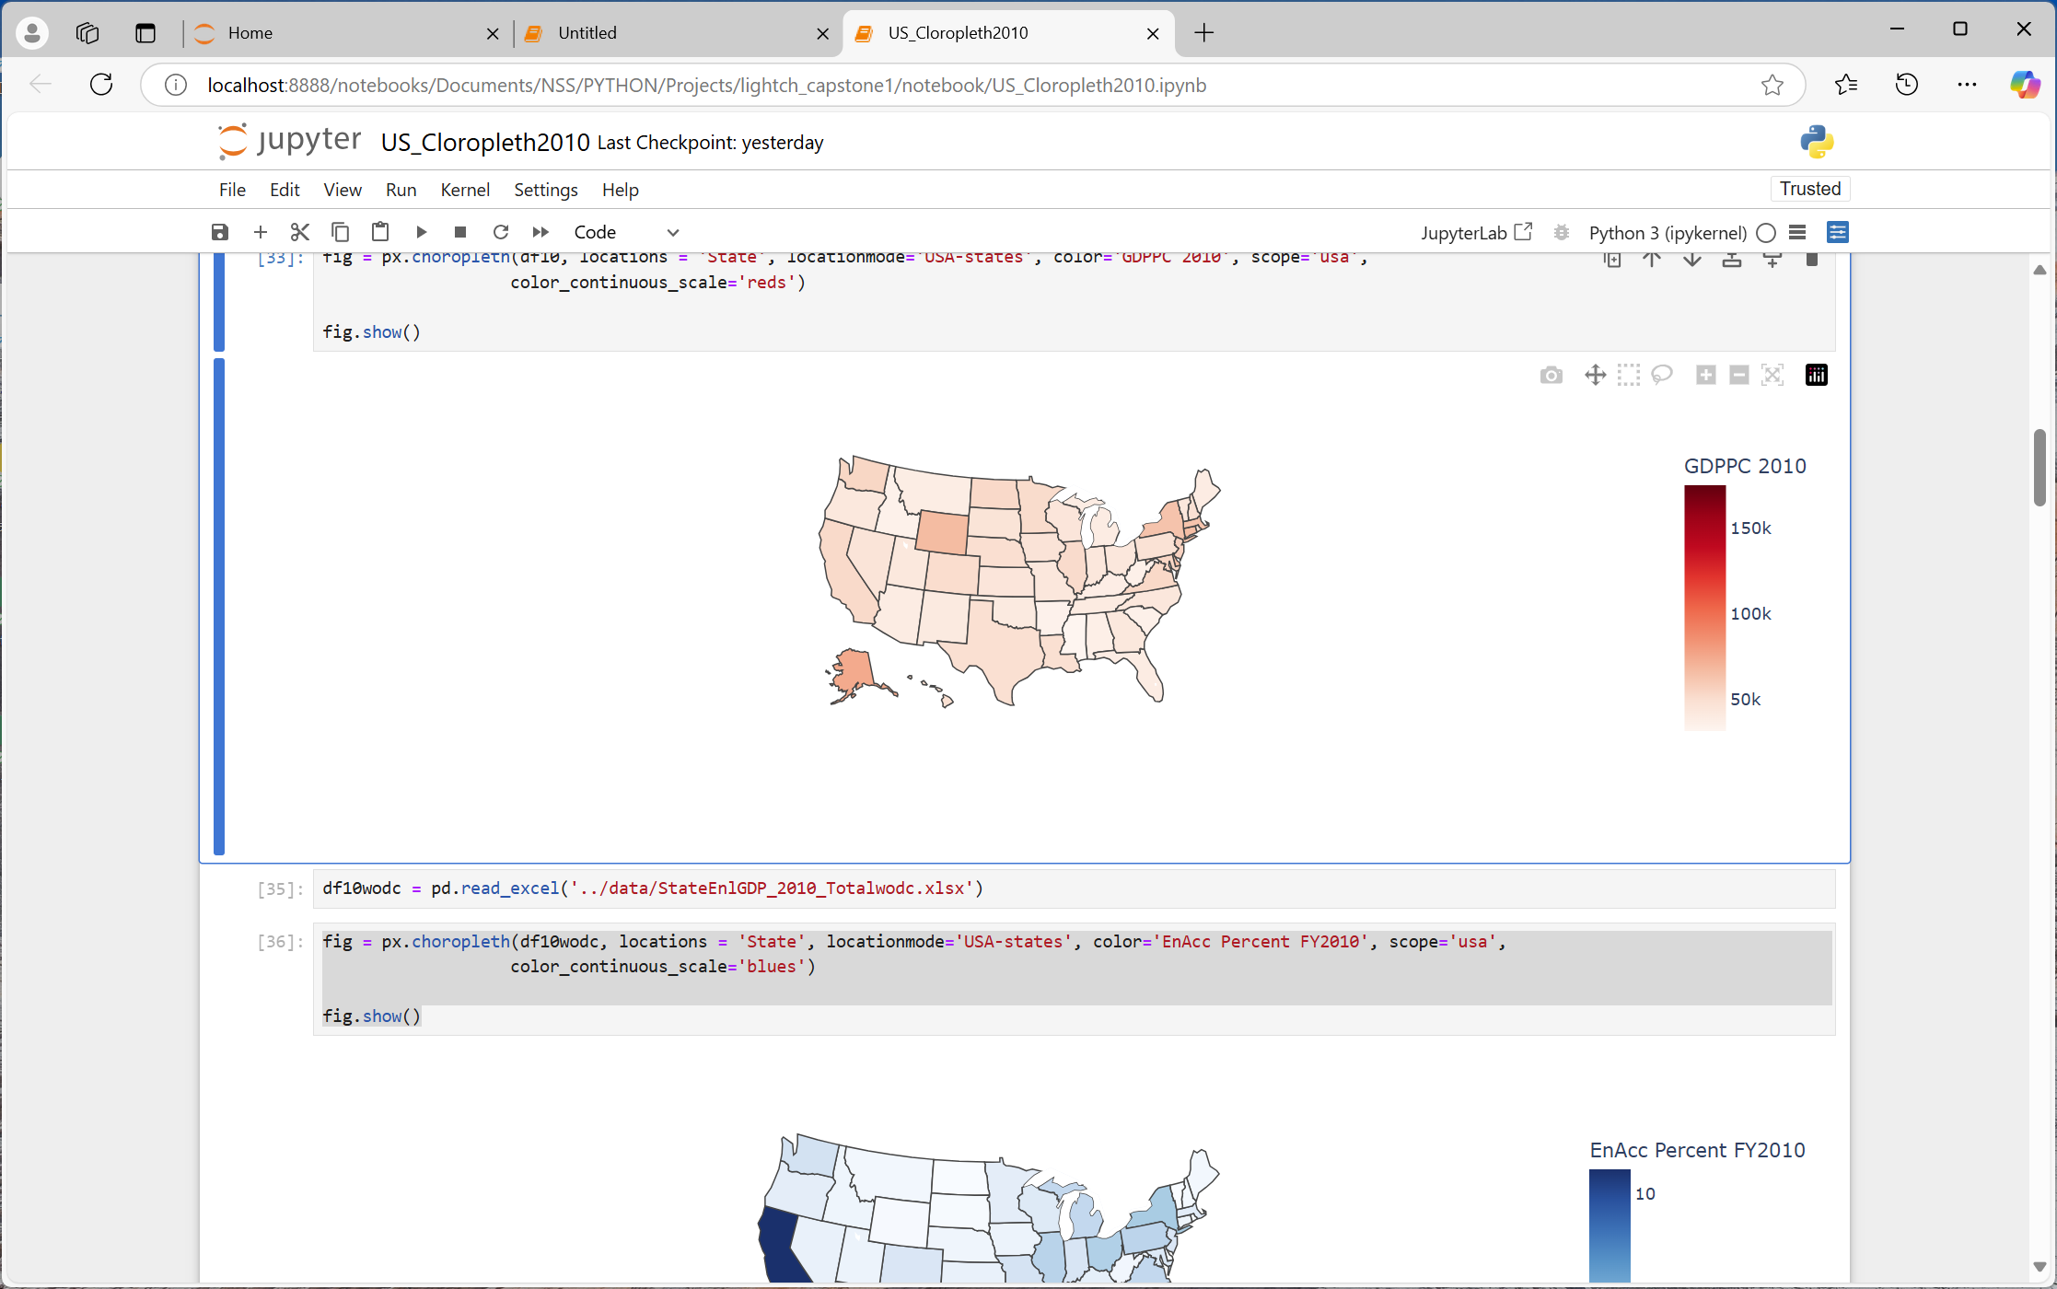
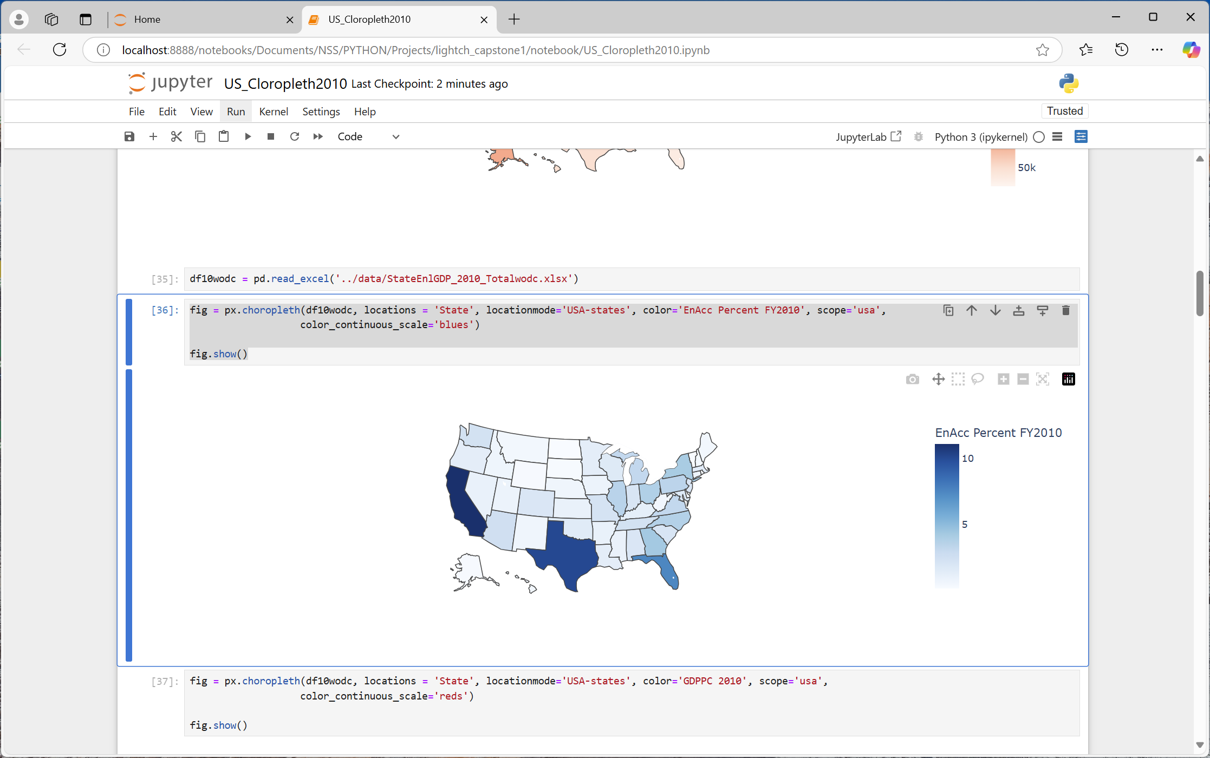
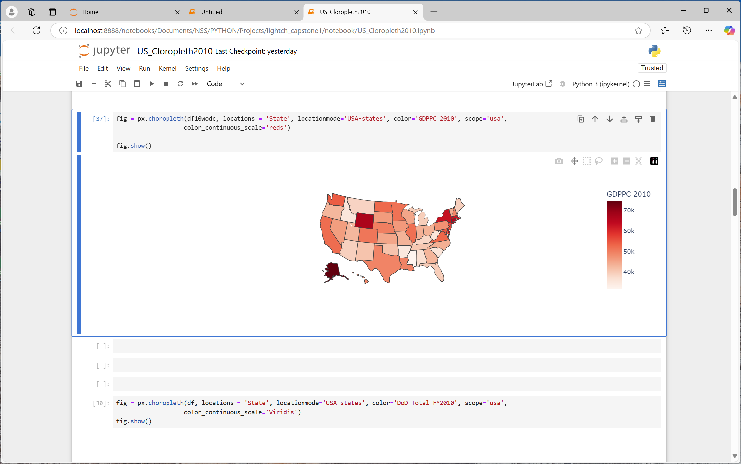
METHODOLOGY NOTE (2010)
WITH DC
WITHOUT DC
Notes:
The note is I removed Washington DC from the data.
On the left I am showing the percent enlisted accession in FY2010. the top left quadrant is with DC and the bottom left is without DC and there isn’t a big difference.
However, moving to the maps on the right, the top right is GDP per capita in 2010, GDP data is calendar year, but the top right map includes GDP per capita for DC and the bottom right is without DC. The heat map shows a marked difference and the scale went from 150K to 70K as the last tick mark. For GPC per capita, I removed DC from the data. So let’s see what that does to previous calculations.

Slide 24
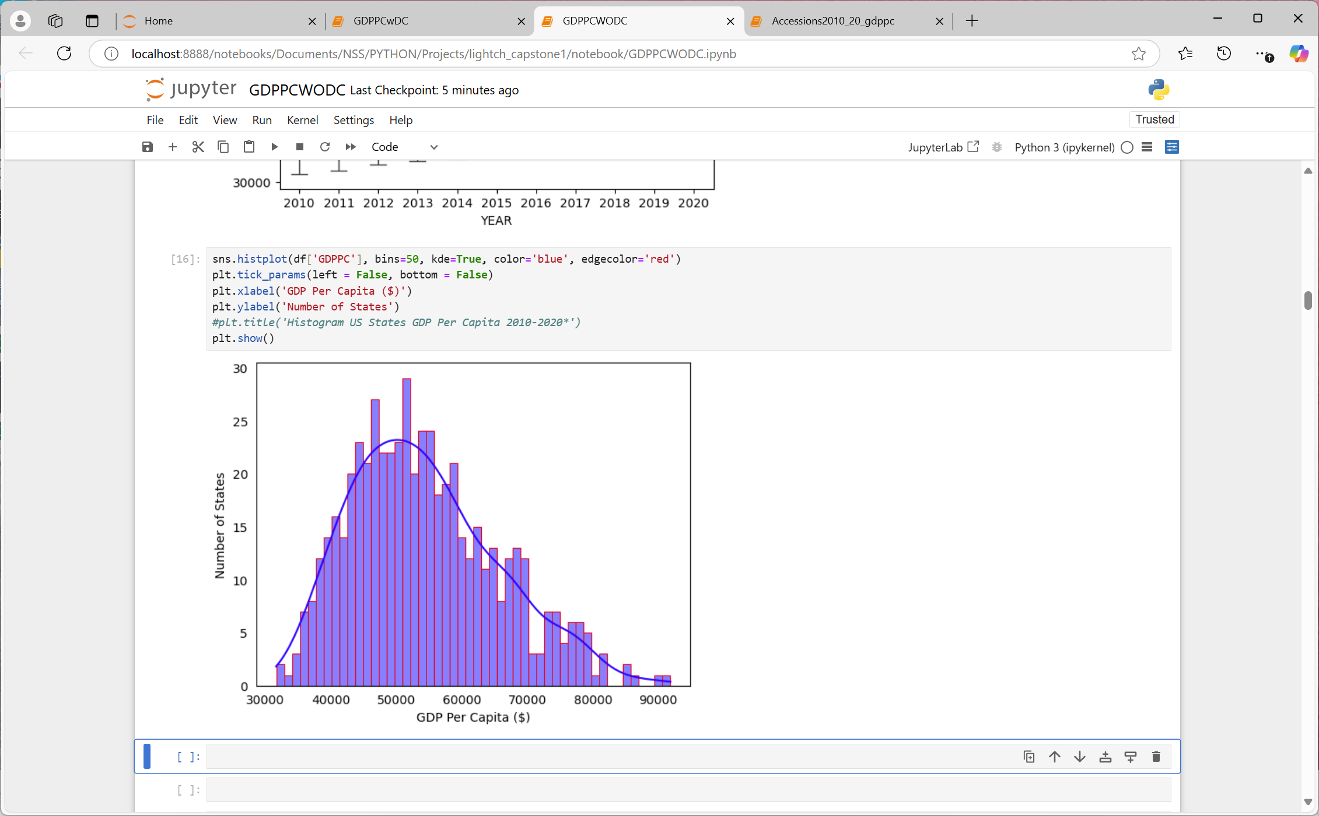
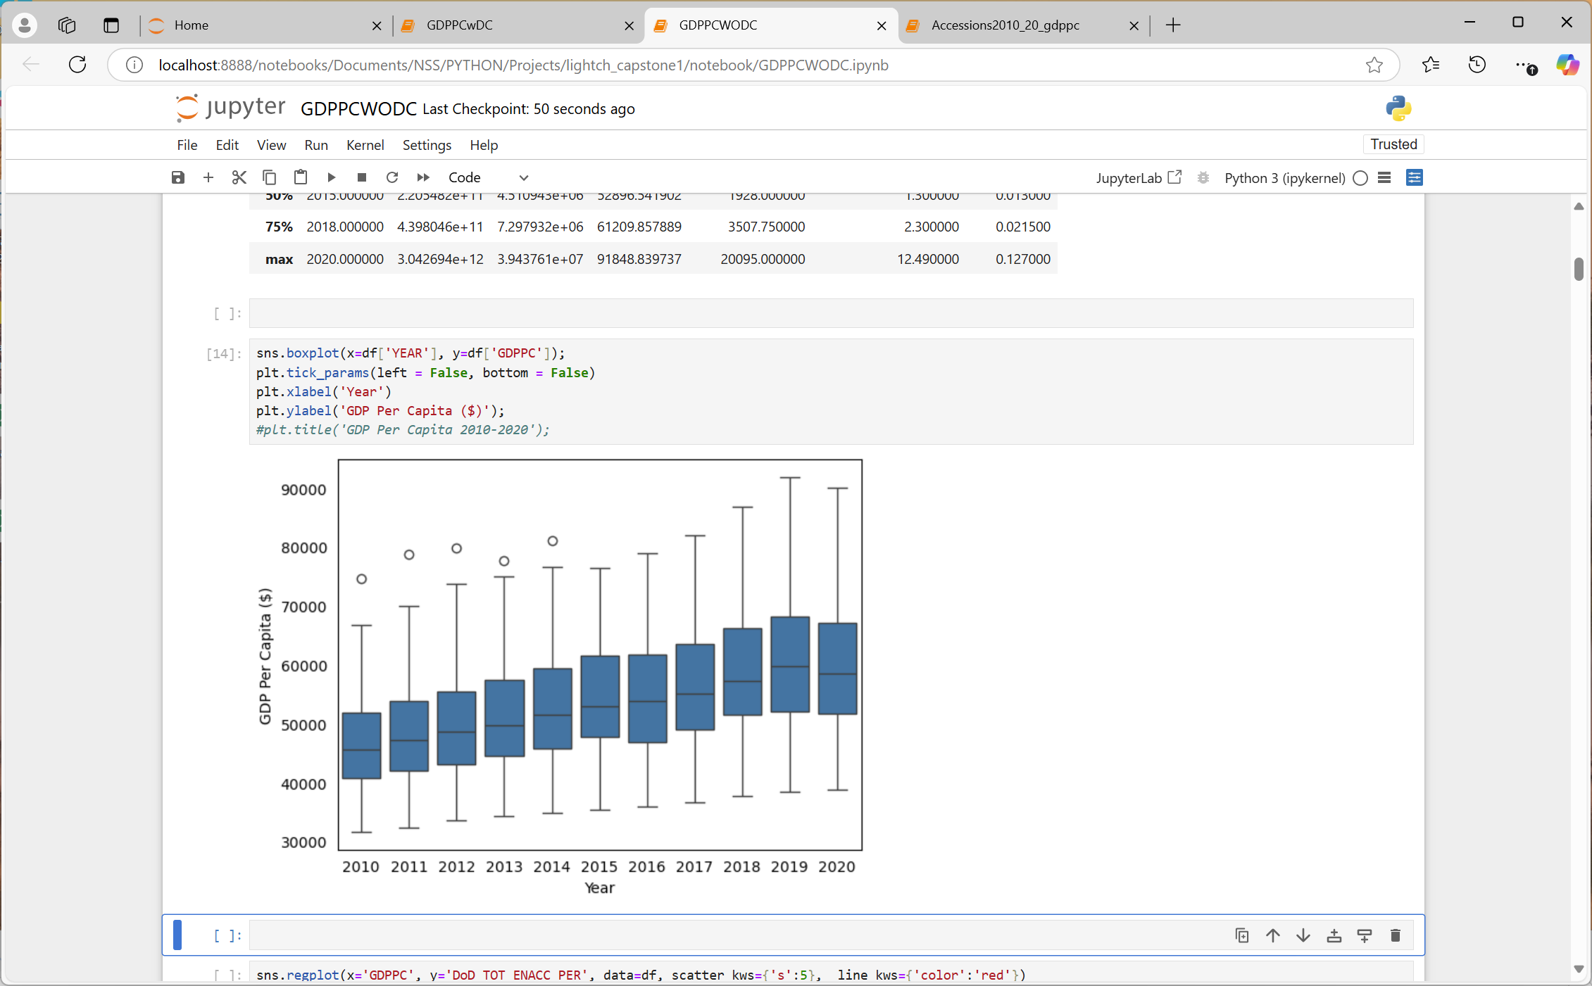
US GDP PER CAPITA 2010-2020*
PQ3: Is there a relationship between GDP Per Capita and Enlisted Accessions?
*Washington DC removed –bottom graphs
Notes:
The top graphs you have seen and the data includes Washington DC. The bottom graphs are without GDPPC for Washington DC and you can tell the difference. The distribution are less skewed, more normal, which may give us a better feel for the relationship between GDPPC and ENACC across these years.

Slide 25
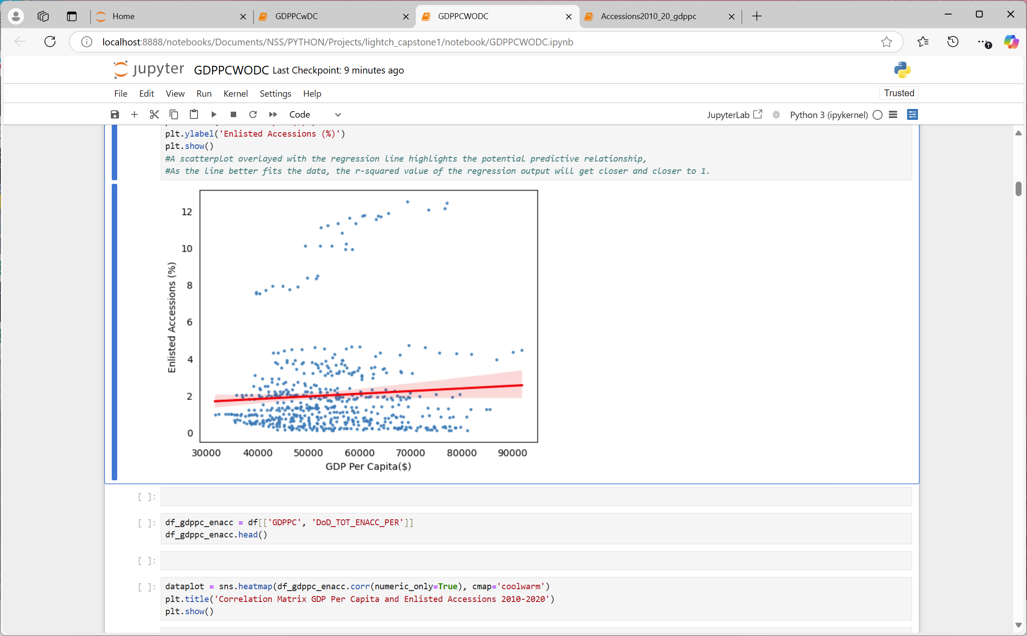
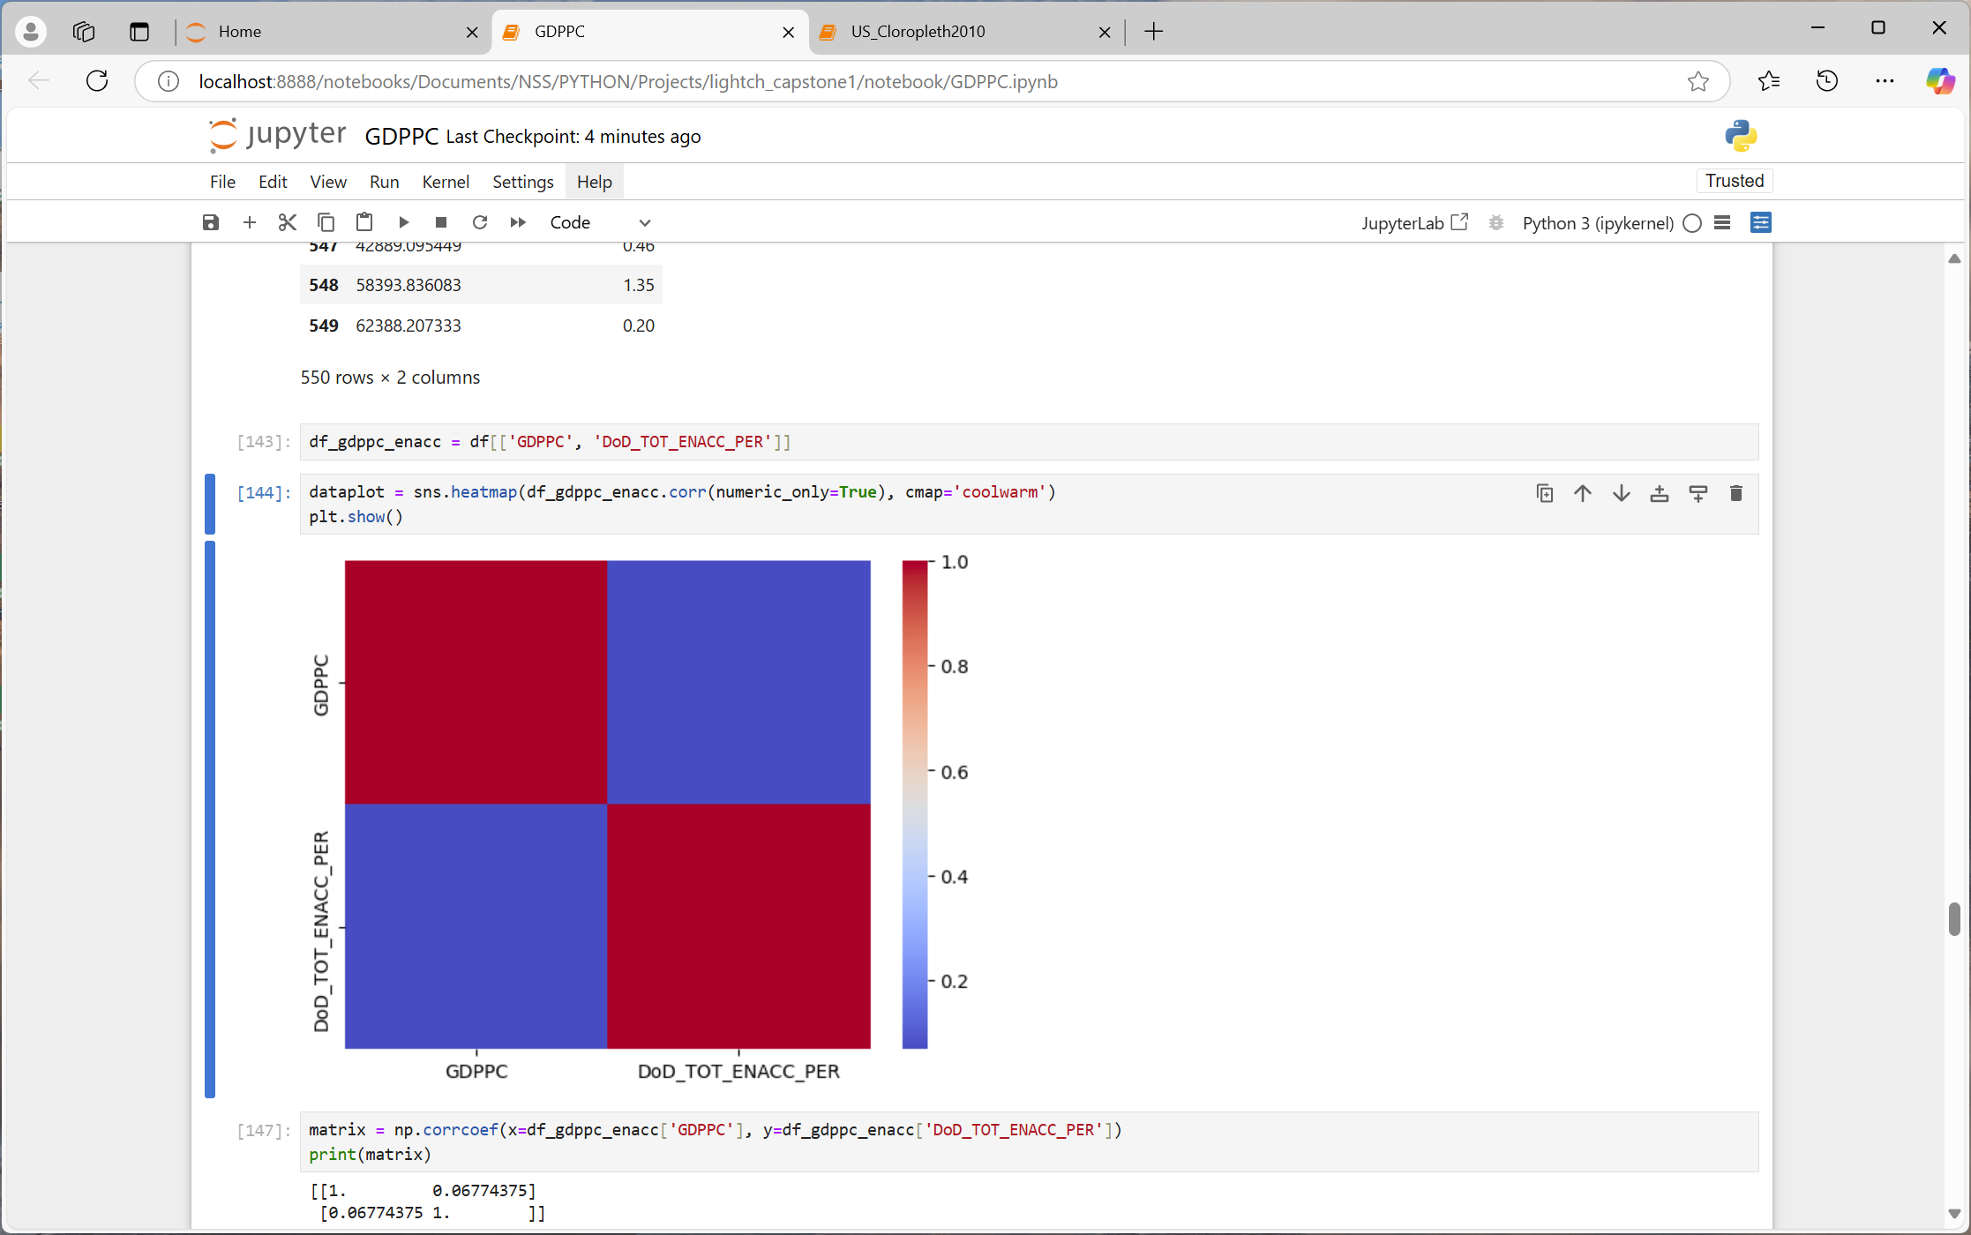
GDP PER CAPITA & PERCENT ENLISTED ACCESSIONS 2010-2020*
PQ3: Is there a relationship between GDP Per Capita and Enlisted Accessions?
1 | 0.0677
0.0677 | 1
*Washington DC removed
Notes:
so I redid the graphs for the same timeframe, without DC and we can see a difference in the scatter plot and the regression line.
The regression is predicting a positive relationship between GDPPC and ENACC.
And sure enough the calculations show a positive correlation coefficient across time which surprised me. However, the correlation coefficient is still less than point 1, showing an almost non-existent relationship between GDPPC and ENACC.

Slide 26
PROJECT FINDINGS 3
In general, there is a very weak relationship between GDP Per Capita and percent Enlisted Accessions, practically non-existent.
The GDP data for Washington DC seems to skew data for the US. With the DC GDP, there appears to be a negative correlation between GDP Per Capita and percent Enlisted Accessions. Without Washington DC, the data shows a positive correlation.

Slide 27
LIMITATIONS
Data:
My focus is on Active-Duty enlisted recruiting from FY2010 to FY2020, however, I include recruiting data from 1954 forward, to show more defined trends
Accessions reported for 1954-1963 include males only; including females would increase accessions by less than 2 percent.
Enlisted data from 1954 through 1973 likely includes draft/conscription numbers, not just volunteers
GDPPC calculated manually from US Census population estimates and Bureau of Economic Analysis

Slide 28
SUMMARY
PQ3: Is
there a relationship between GDP Per Capita and Enlisted Accessions?
PQ1: What are the Enlisted Accession trends over time?
PF3: No. The correlation between GDP Per Capita and Enlistment is very weak
PF1: Enlisted Accession have been decreasing over time
PQ2: Are
there areas
where Enlisted Accessions differs from the population?
PF2:
*NORTHEAST< *MIDWEST< *SOUTH> *WEST =
PROPOSED NEXT STEPS
Examine demographic trends impacting enlisted accessions
Notes:
This is a summary of my questions and findings based on the data I used, and if I had more time, I’d examine demographic trends impacting military recruiting.
*GDP (Gross Domestic Product) is not specifically considered a demographic trend12345. However, demographic changes can influence the economy through factors such as living standards, savings rates, consumption, and investment.
Military Occupational Specialty (MOS)
Air Force Specialty Code (AFSC)
Navy Enlisted Classification (NEC)

Slide 29





Notes:
In conclusion, I really had a good time with this but the young folks depicted in this presentation was what this project was all about for me, so thank you for letting me share!

Slide 30
CONCLUSION/QUESTIONS
THANK YOU
Notes:
I’ll open the floor to questions or comments.

Slide 31


